Slide 1
Core Solutions in Azure

Slide 2
Azure ai services
Basics of AI and Machine Learning
● The replication of human intellect and skills by computer software is known as Artificial intelligence.
● Machine Learning is a subset of Artificial Intelligence in which a computer program is "trained" to draw inferences and make predictions from data.
● Building a machine learning model involves first training the model using our data, then packaging and verifying the model.
● If we are satisfied with the findings, we can deploy the model; if not, we can retrain the model until it achieves the efficiency and accuracy that we need.

Slide 3
Azure machine learning (paas)
Azure Machine Learning assists us by offering a collection of tools such as notebooks based on well-known languages such as Python or R and some visual tools that allow us to construct machine learning models using easy drag and drop right in the portal without installing any software. It includes a large number of pre-built datasets that we may use to test our machine learning models.
Features:
● Azure Machine learning Pipelines are used to coordinate model training, deployment, and administration activities.
● Azure Bot Service is a service that assists us with engaging chat experiences with humans through a Virtual Agent.
● There is also a service called Azure Cognitive Services that is being used to address a variety of issues, such as evaluating text for emotional sentiment or analyzing pictures for object or face recognition.

Slide 4
Azure functions (serverless)
Azure Functions is a serverless computing service that is available in azure. It supports a variety of development languages, such as C#, F#, Node.js, Java, or PHP.
Features:
● Like many of the Cloud Services, it uses a pay-as-you-go model. It is possible to connect it with a variety of Azure services. Charges are only incurred when a function is triggered, and also, Azure Functions scales automatically.
● We can execute the small pieces of code using Azure Functions without having to worry about the underlying infrastructure.

Slide 5
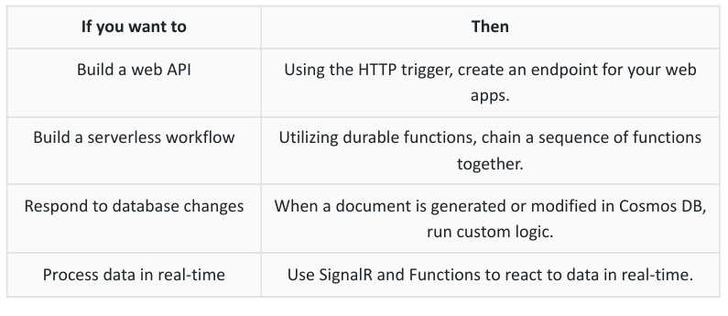

Slide 6
Azure IoT:
Using the HTTP trigger, create an endpoint for your web apps. Utilizing durable functions, chain a sequence of functions together. When a document is generated or modified in Cosmos DB, run custom logic. Use SignalR and Functions to react to data in real-time. The term Internet of Things refers to any gadget with a sensor. A sensor receives analog data and converts it to a digital signal before transmitting it to a central server through an onboard network connection, such as a wifi radio.
IoTHub (PaaS)
It is a managed service accessible via the cloud that allows for two-way communication with your IoT devices. Telemetry data could well be routed via it. IoTHub allows you to manage IoT devices by provisioning them and updating them.
IoT Central (SaaS):
It's a cloud-hosted management IoT application platform for companies that want to govern the devices, data coming out of their IoT devices, and building an entire application for that rather than simply getting raw telemetry data. To help developers build an application, IoT central has built-in templates grouped by a specific industry. It can also be used to create an application from scratch using Solution Accelerators.
Azure Sphere:
It is used for developing very secure end-to-end IoT Solutions. It’s a big step forward in the standardization of IoT devices. The things that Azure Sphere deliver are:
● Azure Sphere OS based on Linux
● Azure Sphere certified chips
● Azure Security Service trusted device-to-cloud communication

Slide 7
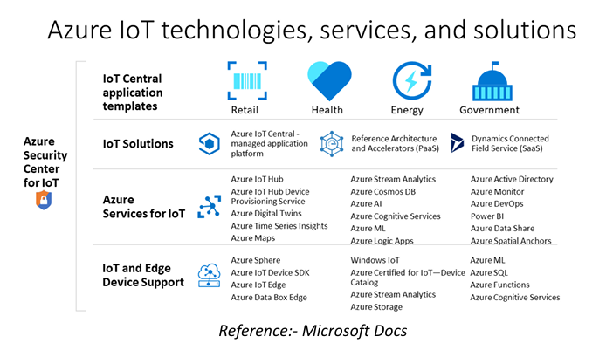

Slide 8
Azure DevOps: Azure DevOps is just an umbrella service for a plethora of different development services.
The various kinds of Azure DevOps Services are mentioned below.
Azure Boards: It used to Deliver value to your users more quickly by using tried-and-true agile technologies to plan, monitor, and discuss work across your teams.
Azure Repos: It is a version control management tool available in azure. It supports both TVS and Git.
Azure Pipelines: Azure Pipelines is a continuous integration (CI) and continuous delivery (CD) solution with a lot of features. It integrates with your chosen Git provider and can be deployed to several big cloud providers, including Azure.
Azure Test Plans: This is a great tool for testers who are having difficulty communicating to developers on what sort of issues they have with their product.
Azure Artifact: This is a private package manager tool available in azure.
Azure DevTest Labs: This tool is used to create a dev-test environment for your developers.

Slide 9
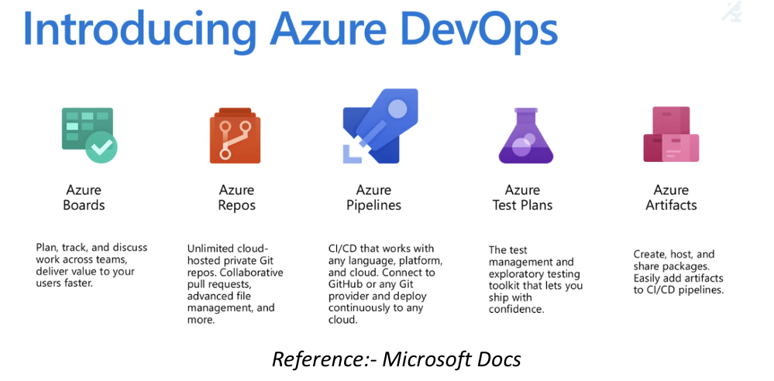

Slide 10
BigData and Analytics On Azure
Azure SQL Data Warehouse
It is an enterprise data warehouse that is used to storing petabytes of data. It is used for performing query analysis. In this, the data is stored in such a way that it improves the query performance.
Azure HDInsight
Azure HDInsight is a fully managed, highly available open-source analytics service. It can be used to run infamous frameworks like Hadoop, Apache Spark, Apache Hive, etc.
Azure Data Lake Analytics
Azure Data Lake Analytics allows you to run queries on terabytes or petabytes of data. It uses a special kind of query language called U-SQL.
Azure Synapse Analytics Service
This is an analytics service used to build an enterprise data warehouse and big data analytics solution.
Azure Data Bricks
This is an Analytics service that is based on only Apache Spark. Using Azure Data Bricks, you can create fully managed, dynamically auto-scalable Apache Spark clusters.

Slide 11
